Slide 1
Revenue Management
(MATH6164)
Case Study
World Cruise
GROUP 9:
Ruben Martinez - 31501818
Vyom Khanna - 28965736
Yuto Otsuka - 30907136
Keon Kim - 34413286
Yixuan Gao - 34742751
Zixu Hou - 34955399

Slide 2
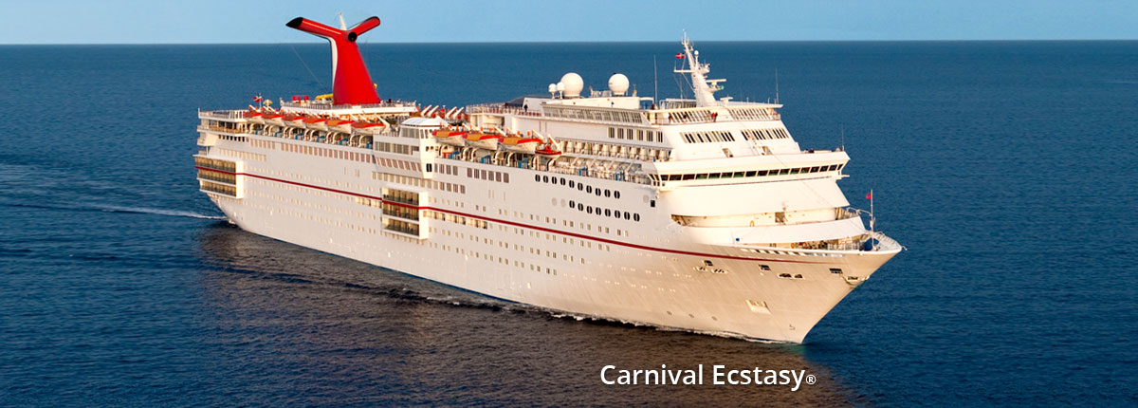
Introduction
This presentation dives into Carnival Cruise Line's revenue management strategies, by analysing WorldCruiseData2024.csv and identifying two or more possible scenarios where the demand and revenue of the cruising can be affected in 2025.
Objectives:
Use scenarios to estimate demand in 2025
Formulate LP problem to maximise the revenue for each scenario
Identify cancellation rate
Solve overbooking problem
Figure 1: Carnival Cruise Ship

Slide 3
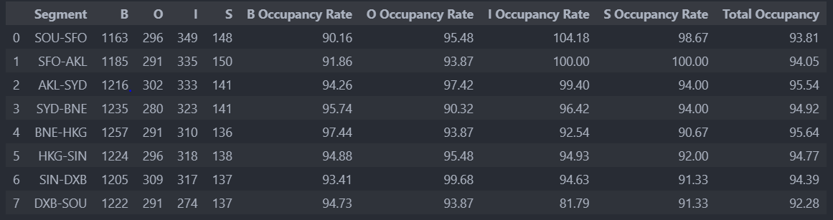
Summary of the data
Occupancy Rate:
Figure 2: Occupancy Summary Table
SOU-SFO room type I has overbooking

Slide 4
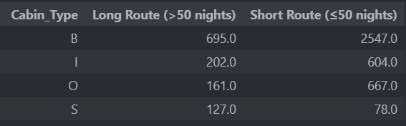
Long Routes vs Short Routes
Figure 3: Table to show number of people that are on each cabin per different cruise length
Short routes passengers prefer cheaper rooms than long routes passengers.
Exploit cheaper rooms for 2025 demand scenarios.

Slide 5
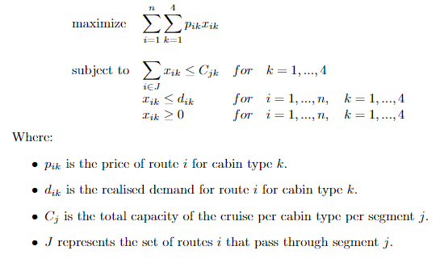
Optimal Passenger Allocation
Figure 4: Linear programming problem to find optimal passenger allocation

Slide 6
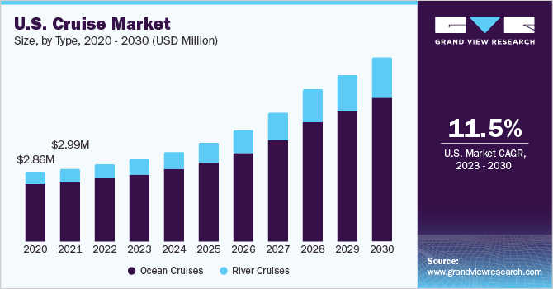
Scenario 1: Market Growth
The cruise industry is projected to experience significant growth from 2023 to 2030, with a compound annual growth rate (CAGR) of 11.5% (short routes and long routes) and 12.5% CAGR in Pacific-Asia region.
Figure 5: Graph of Cruise Market Growth Prediction by grand view research
Source:
www.grandviewresearch.com. (n.d.). Cruise Market Size, Share & Growth Report, 2028. [online] Available at: https://www.grandviewresearch.com/industry-analysis/cruise-market-report.

Slide 7
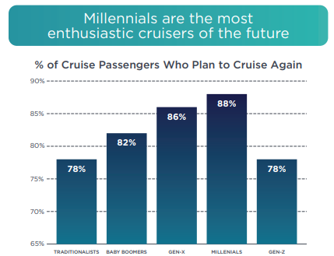
Scenario 1: Market Growth
Reason for the market Growth in 2025:
· Increasing number of Millennial / Gen-Z cruisers
· Cruise vacations are more affordable (Post Covid Recession)
· Improvement in technology contributed cruise to be more environmentally friendly
Assumption:
Perfectly elastic demand (no price change)
Cancellation rate remain constant
Figure 6: The graph to show the interest of different generation for cruising
Source:
CLIA (2023). STATE OF THE CRUISE INDUSTRY. [online] Available at: https://cruising.org/-/media/clia-media/research/2023/2023-clia-state-of-the-cruise-industry-report_low-res.ashx.

Slide 8
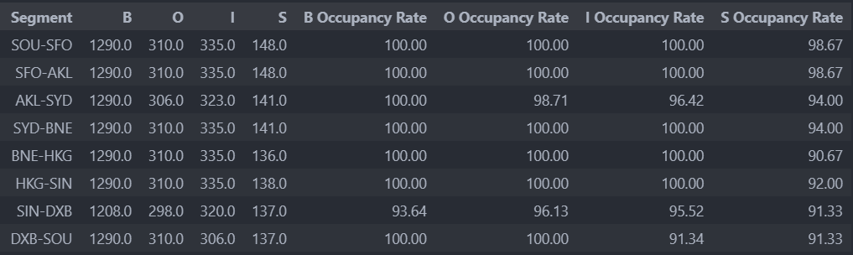
Scenario 1: Optimal Allocation
Figure 7: Optimal Allocation Table for Scenario 1
Revenue = £124,698,118.65
Occupancy rates increase across all routes

Slide 9
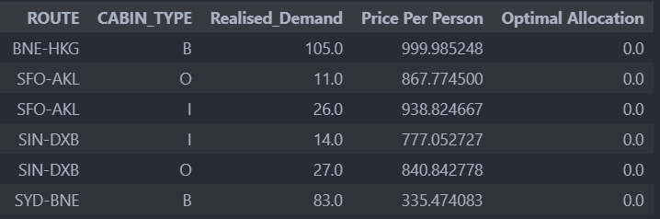
Scenario 1: Optimal Allocation
These are some of the routes and cabin types that the optimal allocation did not meet the realised demand:
Figure 8: Allocation where demand was unmet scenario 2

Slide 10
Scenario 2: Aggressive Marketing
Carnival carry out an aggressive marketing campaign by decreasing the price of cruise tickets for short routes by 5% to promote shorter routes travel.
Assumptions:
The demand of long cruises (> 50 days) will stay the same, but short cruises (< 50 days) will increase based on the elasticities.
The cancellation rates remain unchanged.
Price elasticity of shorter cruises are :
B | O | I | S
-0.8 | -1.5 | -2 | -0.3
Figure 9: Elasticity of demand for each cabin type

Slide 11
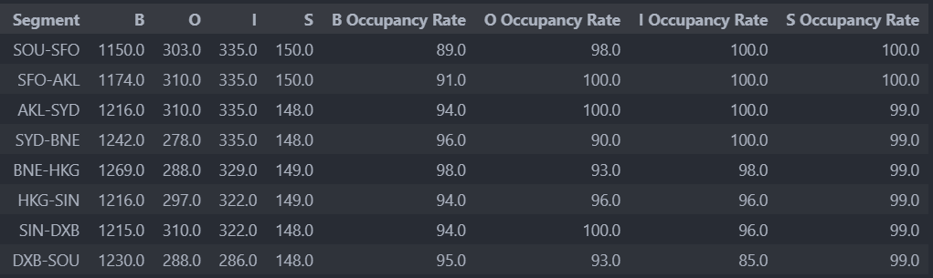
Scenario 2: Optimal Allocation
Figure 10: Optimal Allocation Table for Scenario 2
Occupancy rates for cheaper cabins increases.
Occupancy rate for suites also increases since long term routes remain unchanged.
Revenue = £114,989,353.95

Slide 12
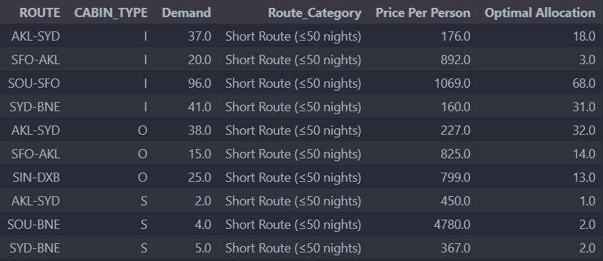
Scenario 2: Optimal Allocation
Figure 11: Allocation where demand was unmet for scenario 2

Slide 13
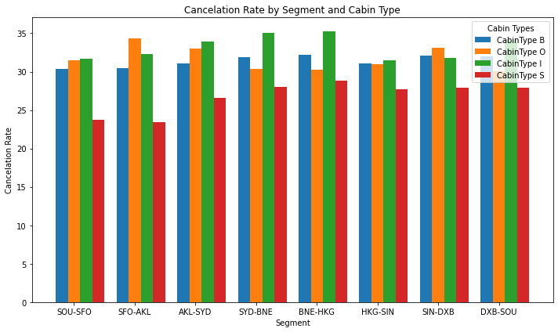
Cancellation Rate
The cancellation rates for the 2022:
For cancellation rates in 2025:
Scenarios have assumed cancellation rates remain constant with increase in demand.
However, in reality cancellation rates may decrease due to:
Improved consumer confidence.
Stricter cancellation policies, aiming to defer speculative bookings.
Adjustment period between increase in demand and adjustment in cancellation rates.
Figure 12: Graph of cancellation rate by segment and cabin type

Slide 14
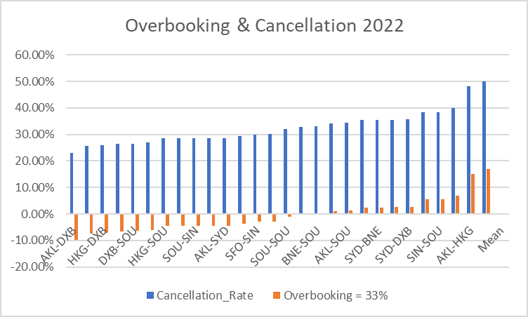
Overbooking in 2022 and 2025
2022 cancellation rate, derived from bookings vs. cancellations in Excel, averaged 33%.
Hence, overbooking occurs for routes with cancelation >33%
Looking at overbooking in 2025:
↑ Demand, then ↑ Overbooking
↓ Demand, then ↓ Overbooking
Assumption:
Cancelation rate are not affected by change in demand
Figure 12: Graph to show overbooking and cancelation

Slide 15
Risk, Rewards and Assumptions
Examples of strategies that carnival can adopt to tackle overbooking problems are:
Conservative Approach (15% Overbooking):
Strategy: Limit overbooking to 15% on routes with high demand.
Assumptions: Assumes stable cancellation patterns.
Risk: Potential revenue loss due to underutilized capacity.
Reward: Enhanced customer satisfaction, lower cancellation costs.
2. Flexible Pricing Model.
Strategy: Adjust prices based on booking trends and cancellations. For example, provide a lower overbooking rate for routes and cabin types with lower cancelation rates.
Assumptions: Price sensitivity affects booking behavior.
Risk: Balancing pricing to maximize revenue without discouraging bookings.
Reward: Optimizes revenue during fluctuations.

Slide 16
Conclusion
Key findings of this project:
Scenario 1 assumes perfectly elastic demand, so the occupancy increases for all routes as the market demand grows.
In Scenario 2, Occupancy for cabin I and O increased as we assumed the demand are more elastic for cheaper cabins.
Considering both scenarios, the overbooking are likely to be more problematic in 2025, as both scenarios indicate increase in demand of cruising compared to 2022 (assuming cancellation late is constant).
Takeaway for Carnival:
Promote cabin type B for short routes (most demanded) due to the nature of the elasticity bookings will be less dependent on price.

